Slide 1


AI Powered Ethical Decision Making
The use of AI is rapidly expanding, leading to crucial questions about ethical implications. This presentation explores the importance of AI ethics and how AI can be designed to promote fairness and well-being.
by Jaggari Vivekanandan

Slide 2
Why AI Ethics Matters
Preventing Unintended Consequences
Promoting Transparency and Accountability
AI systems can amplify existing societal biases, leading to unfair or discriminatory outcomes.
Ethical AI development requires transparency about how algorithms work and who is responsible for their impact.

Slide 3

Challenges with Traditional Decision Making
Human Bias
Limited Data
Human decision-making can be influenced by unconscious biases, leading to unfair outcomes.
Human decision-making often relies on incomplete information and limited data, limiting accuracy.
Cognitive Overload
Complex decision-making processes can overwhelm humans, increasing the risk of errors.

Slide 4




Introducing AI-Powered Ethical Frameworks
1
AI Ethics
Principles
2
Fairness, Transparency, Accountability
Guidelines
3
Data Privacy, Bias Mitigation, User Consent
Tools
4
Risk Assessment, Impact Analysis, Bias Detection

Slide 5
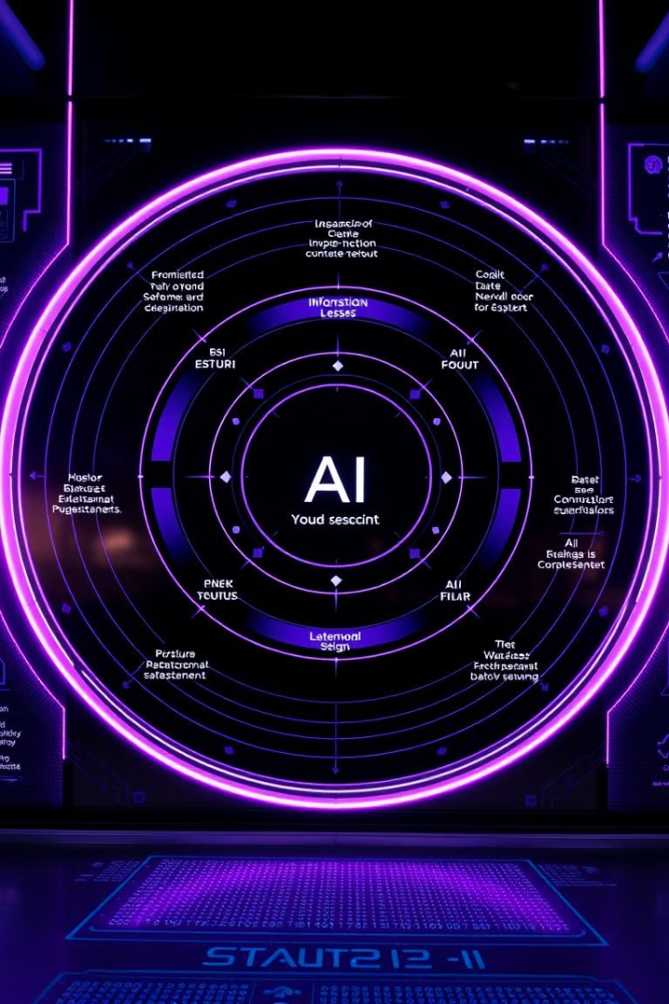
Key Principles of Ethical AI Systems
Fairness
Transparency
AI systems should treat all users fairly, without discrimination based on protected characteristics.
The design, development, and operation of AI systems should be transparent, allowing for public scrutiny.
Accountability
Clear lines of accountability should be established for the actions and outcomes of AI systems.

Slide 6



Implementing Ethical AI: Case Studies
Healthcare
Criminal Justice
AI-powered diagnostic tools are being used to improve patient care, but ethical considerations are essential.
AI-driven risk assessment tools are being used in criminal justice, raising concerns about bias and fairness.

Slide 7

Mitigating AI Bias and Ensuring Fairness
1
Data Bias Mitigation: Addressing biases in training data to ensure fairness.
2
Model Validation: Testing AI models for bias and unfair outcomes before deployment.
3
Explainability and Transparency: Providing clear explanations of AI decisions and how they were made.

Slide 8




The Future of AI Ethics: Trends and Predictions
Increased Regulation: Governments and organizations will develop stricter guidelines and regulations for AI ethics.
AI for Social Good: AI will be increasingly used to address societal challenges like climate change and poverty.
Human-AI Collaboration: AI and humans will work together to solve complex problems and make more informed decisions.

